Slide 1

Identify states with low test scores associated with lower income group across 2017 and 2018 to recommend for funding delegation.
Sufyan, Advisor from Education Board

Slide 2
Context
From Washington’s Post, scores from the ACT show that only 9% of students in the class of 2017 who came from low-income families are strongly ready for college in 2017.
This is a cause of concern, as this disparities in college readiness will put students of lower income to a disadvantage competing with the rest, hence less like to have access to high-quality educational and career planning opportunities and resources
Thus, we will need to evaluate both test across 2017 and 2018 and produce improvement plans.

Slide 3
Data import and cleaning

Slide 4
EDA (Exploratory Data Analysis)
Explore mean scores across 2017 and 2018 Vs Income
 | <$41,000 | $41,000-$45,000 | $45,000-$51,000 | >$51,000
sat_total_2017 | 1131.85 | 1135.17 | 1152.23 | 1085.85
act_comp_2017 | 20.11 | 20.93 | 21.86 | 23.14
Not much association with SAT scores
 | <$41,000 | $41,000-$45,000 | $45,000-$51,000 | >$51,000
sat_total_2018 | 1105.92 | 1142.25 | 1127.46 | 1106.15
act_comp_2018 | 20.02 | 20.61 | 22.18 | 23.11
The higher the income the higher the ACT composite score

Slide 5
Consistent lowest performing states in 2017, 2018
List of low performing ACT test scores: Nevada, Mississippi, South Carolina and Hawaii
Mean score difference is about ~2.97
List of low performing SAT test scores: District of Columbia, Delaware, Idaho
Mean score difference is about ~140
 | act_eng_2017 | act_math_2017 | act_read_2017 | act_sci_2017
mean | 17.52 | 18.64 | 18.96 | 18.90
median | 17.80 | 18.60 | 19.10 | 18.90
std | 0.73 | 0.60 | 0.56 | 0.45
count | 5.00 | 5.00 | 5.00 | 5.00
Amongst the 5 lowest states, English is found to be lowest by 1 score

Slide 6
Participation rate changes over 2017, 2018
Following states had huge change in participation rates from 2017 to 2018
ACT:
Colorado from (100% to 30%) (Source)
Illinois from (93% to 43%) (Source)
Following states had huge change in participation rates from 2017 to 2018
SAT:
Colorado from (11% to 100%) (Source)
Illinois from (9% to 99%) (Source)

Slide 7
Test Score changes over 2017, 2018
Colorado sees biggest jump in ACT grades, while SAT scores dropped by similar percentage of about 14.6%.
This is likely due to an effect whereby lower participation rates have average scores reflective of smarter and better prepared students who voluntarily taking the test.
(Source)
Following states had huge change in test score from 2017 to 2018
ACT:
Colorado (+14.9%) (Source)
Illinois from (11%) (Source)
Following states had huge change in test score from 2017 to 2018
SAT:
Colorado (-14.6%) (Source)
Illinois from (-8.6%) (Source)

Slide 8
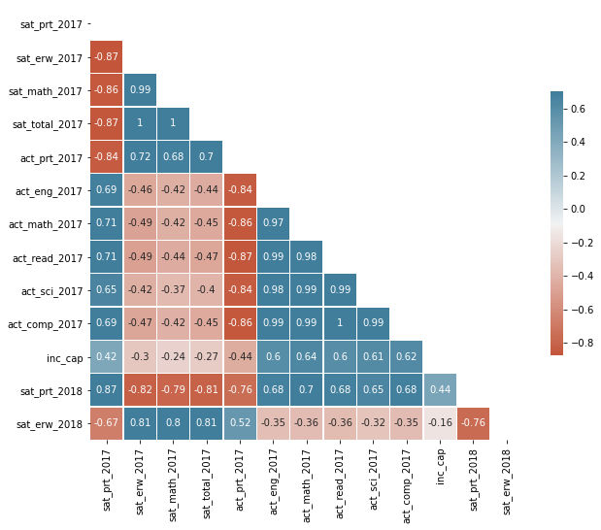
Heatmap on correlation of all numerical variables
General observations
1) Higher participation rates for SAT/ACT will have negative correlation with ACT participation rates (-0.76 ~ -0.87)
Suggest it might be attributed by mandate of each state to do either one of the test
2) SAT scores does not have strong correlation with income (-0.14 ~ -0.27)
3) ACT scores have a stronger positive correlation with income (0.44 ~ 0.62)
4) Participation rate has high negative correlation with scores across both test, meaning the higher the participation rate, the lower the scores.
SAT (~-0.8)
ACT (~-0.8)

Slide 9
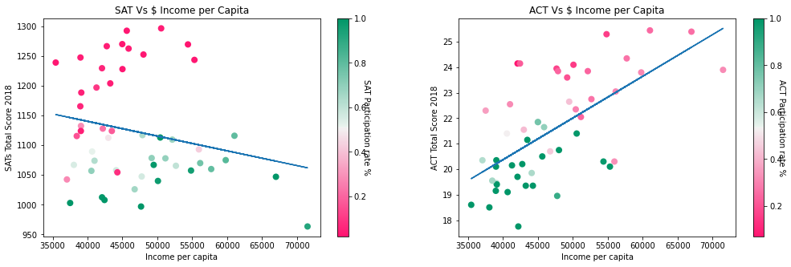
Income Vs ACT/SAT scores
Observed that the ACT scores have positive correlation with the income levels of the students about 0.6. On the contrary, the SAT scores showed little correlation with income about -0.2
We need to dissect the graph further by looking into the participation rates closely.

Slide 10
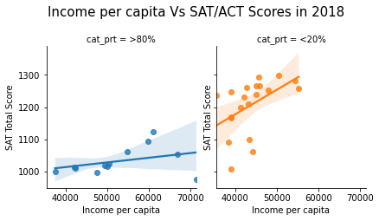
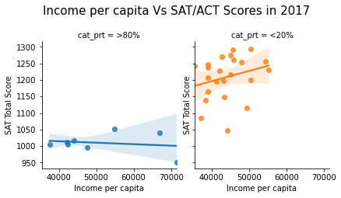
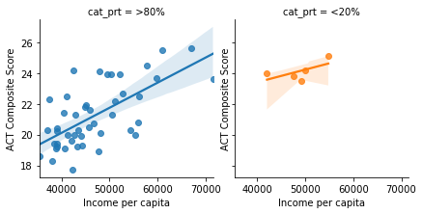
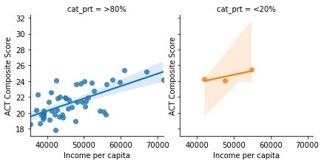
Income Vs ACT/SAT scores
When split by participation rates between the <20% and >80%, can see positive correlation between income and SAT/ACT scores

Slide 11
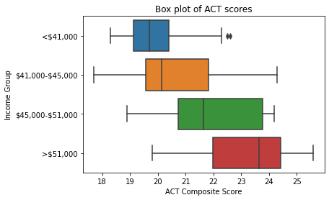
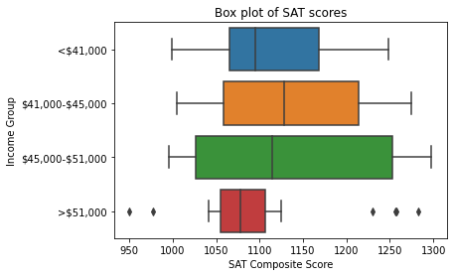
Boxplot by Income Group vs Scores
Observed disparity in ACT scores vs income levels of students.

Slide 12
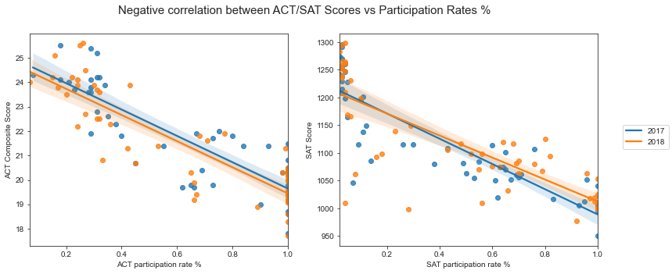
Linear regression plot between scores and participation rates
Noted huge cluster of high scoring SAT students below participation rate of 20%
At least 13 states has scored more than 75% percentile for SAT scores across both years

Slide 13
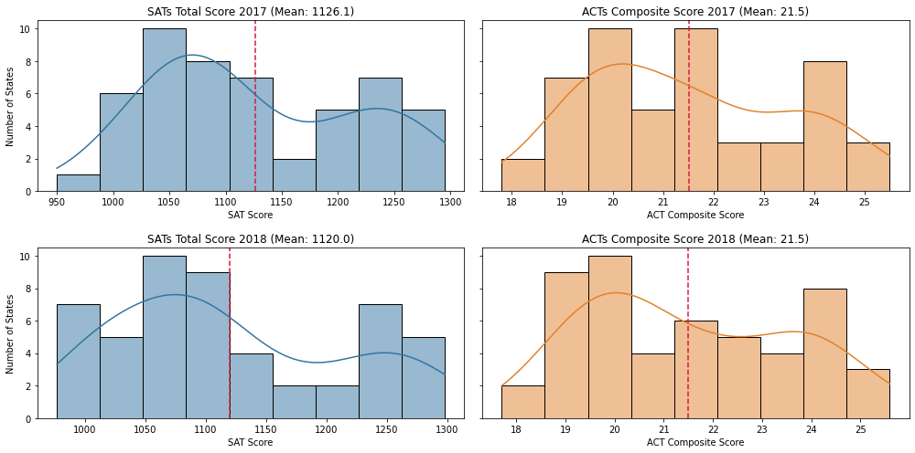
Histogram plot SAT/ACT scoress across 2017 and 2018
Observed bi-modal distribution on the average scores across 2017 and 2018
Distribution seems to be right skewed
Mean score for SAT decreased from 2017 to 2018

Slide 14
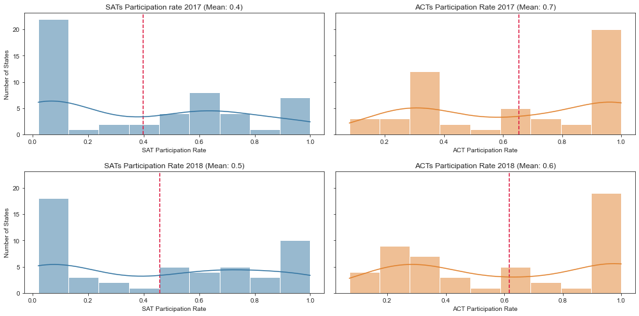
Histogram plot for SAT/ACT participation rates
Observed bi-modal distribution on the average participation across 2017 and 2018
Mean increased from 2017 to 2018, exhibiting higher counts of states on the right side of the histogram.

Slide 15
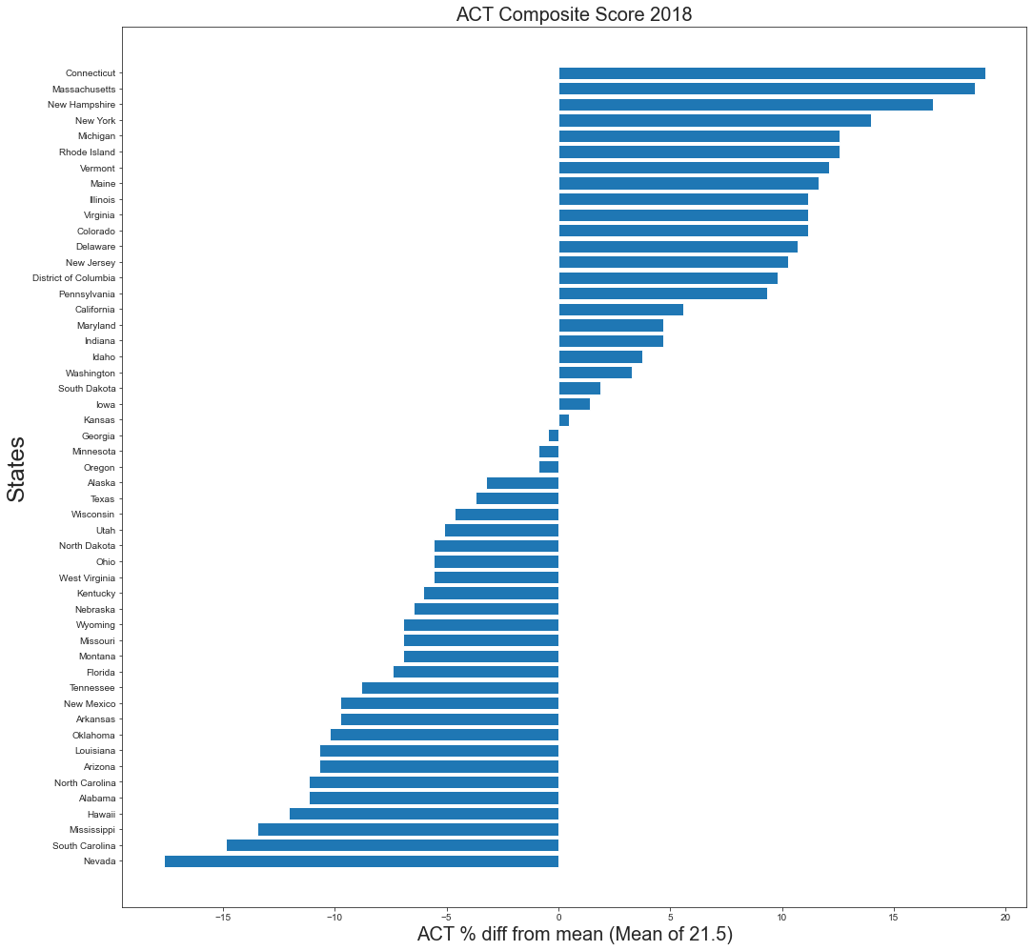
Histogram of percentage difference VS Statewide mean (21.5)
4 consistently lowest states for ACT
Nevada
South Carolina
Mississippi
Hawaii
Also falls under lower income group

Slide 16
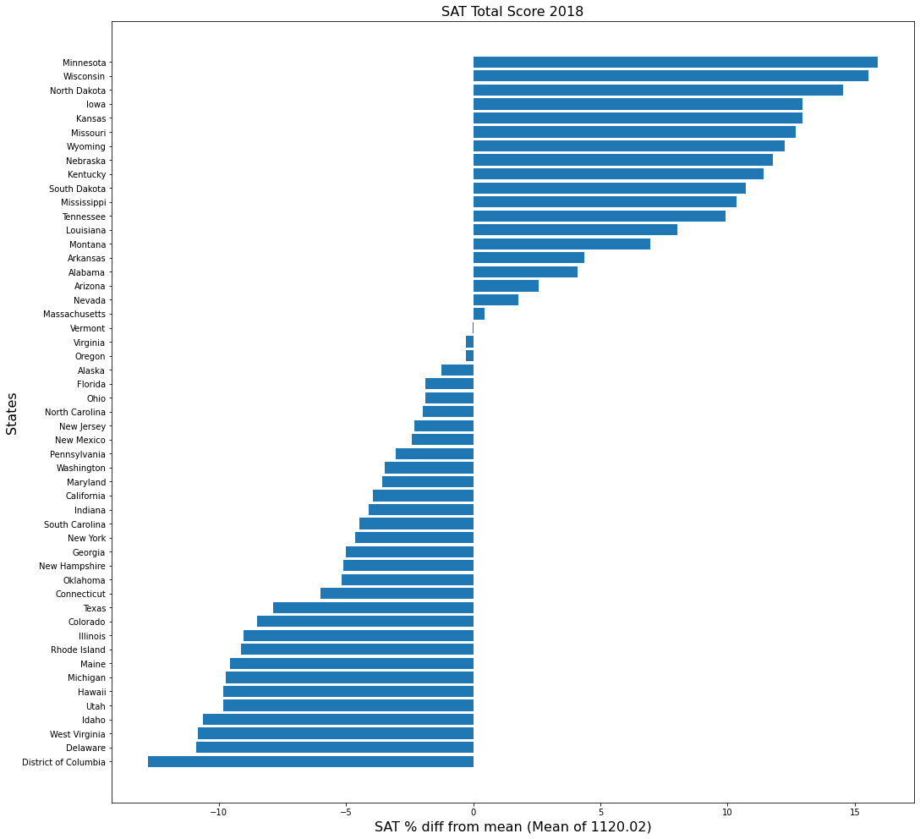
Histogram of percentage difference VS Statewide mean (21.5)
3 consistently lowest states for SAT
District of Columbia
Delaware
Idaho
Also falls under lower income group

Slide 17
Conclusion & Recommendation
In order to help bring up the overall likelihood of most students having better chances to enter college and essential prep and resources, we would like to recommend;
Allocating more funding / test preparation resources in states with lower income per capita such as Nevada, Mississippi, South Carolina and Idaho.
Recommend states to provide free waiver especially for lower income to access to OPL, Online prep live. Reports from OPL mentioned that one academic year associated with an average score of 1.64, especially boosting up students from the lower income group. (Source)
Recommend allocating more resources that helps students in their weakest subjects, typically pulled down by English was the weakest amongst lowest income group for ACT . SAT has Math as the weakest among lower income group

